Slide 1

BlindVision
AI-powered system to help blind people in everyday life
Notes:
Hi everyone, I am Sergei, and we are BlindVision, we help blind people in everyday life with the power of AI

Slide 2

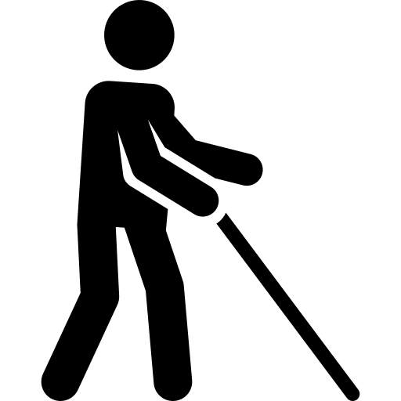
Helping visually-impaired is essential
Around 3.5% of people have visual impairment, out of which 0.5% are blind.
Accessibility is a problem everywhere
Example:
buying groceries
Notes:
According to WHO, The prevalence of people that have visual impairment is 3.5%, of whom 0.5% are completely blind.
It is hard for the blind and visually impaired people basically everywhere in the world. In Germany infrastructure is not always suitable for the blind, for example when you need to find a correct bus or route.
An example would be when one wants to buy groceries. What you need to do is to ask for help from the staff, or go to a shelf and scan every item until you find a match with what you need.
This is when BlindVision comes in

Slide 3
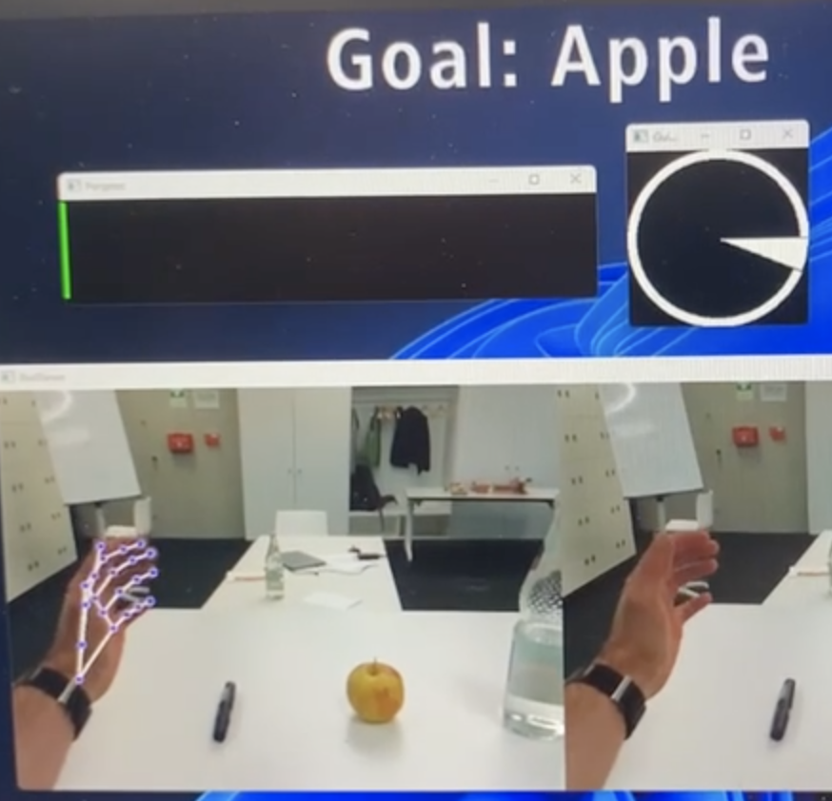


The solution
Our product
Guidance system
Query an item
CV identifies objects
3D camera navigates a user
Vibrations or sounds as a feedback
Value proposition
No need to scan all items
More independent
Increased quality of life
Notes:
At BlindVision we developed a solution to help people who have trouble seeing to buy groceries.
Our product is a simple to use AI-powered guidance system which clues the user by vibrations or sound towards a product on a shelf.
On the left you can see the screenshot from the application, and the video demo will be on the next slide.
The guidance system queries a user on the product he or she wants, and the Comp. vision system find this object on a shelf. Next the 3d camera mounted on a chest navigates a user’s hand toward the object through vibrational or sound signal.
THe value proposition for the used would be that there is no need to scan all items for a particular brand or flavour, allows a user to be more independent in the groceries routines, and overall increase in the quality of life

Slide 4
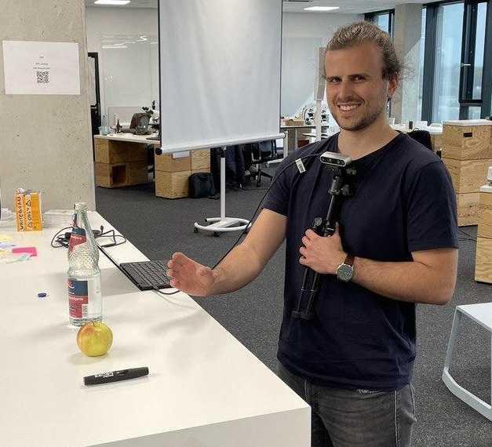
Video demo
Notes:
Medialab library for hand detection, yolo5 model for object detection, everything runs on opencv library in python. The 3d coordinates of the hand and an object are from the the Intel depth camera which allows to calculate the 3d distance and direction between and object and a hand. Everything runs on the local CPUs.
Among the problems we faced were the first camera we tested had was not suitable for close operations within arm length. The frame rate is also not perfect because of the CPUs used in the local environment. We had also problems with object detection and tried a few different models of different parameter sizes and selected the best.

Slide 5
Future work
The current solution is a part of a bigger system
Full guidance system for a supermarket
navigate through the aisles
Select the appropriate section of shelves
Select items in a shelf <- this hackaton
Notes:
The current solution is a part of a bigger system we had in mind.
This was first conceived as a part of a supermarket guidance system, which include the navigation through aisles, selects the shelves sections and finally helps to pick up objects

Slide 6

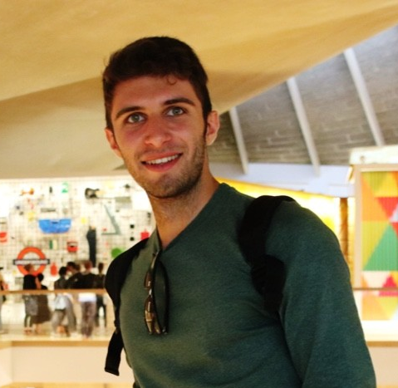
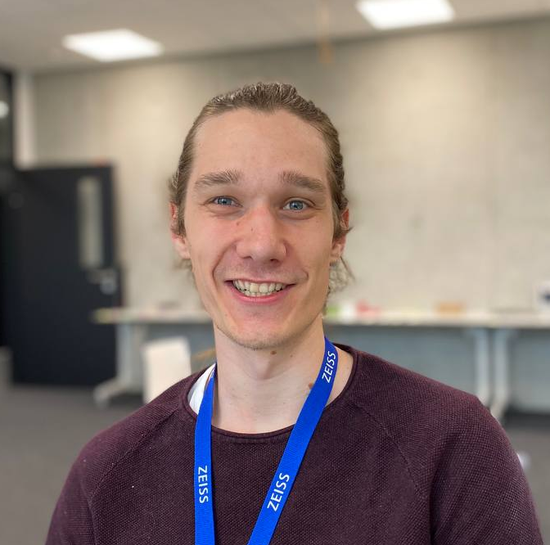


Our team
Sergei Bykov
Edoardo Fazzari
Marco Schott
Philipp Licht
Lukas Schölch

Slide 7
Windows of opportunity??

